Slide 1
Project overview(main topics):
Dataset Description
preprocessing steps
choice of machine learning algorithms
evaluation of our model
creation of GUI
code

Slide 2
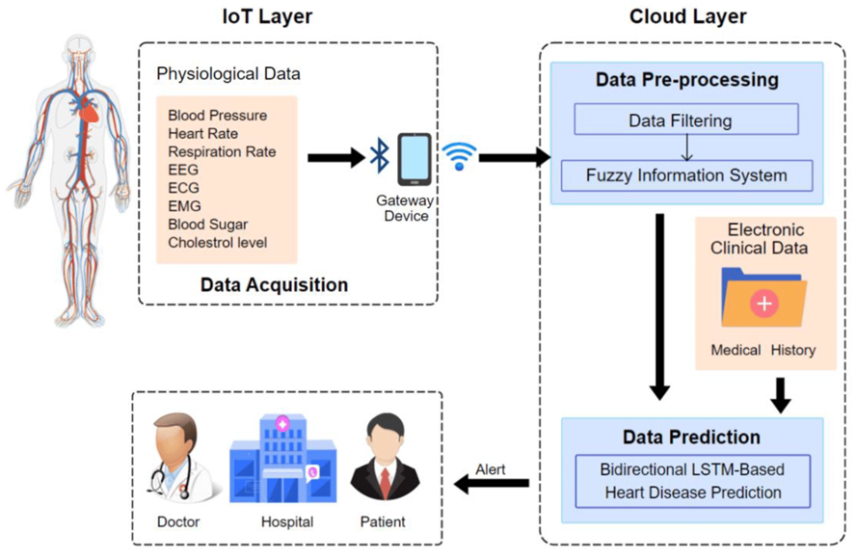
The idea of the project:
Predict heart disease based on
patient data
by building a predictive model to
forecast disease outcomes.

Slide 3
Let’s talk briefly about project:
We used suitable machine learning model and trained it on large datasets containing
information from patients with and without heart disease to learn patterns and make
accurate predictions such:
we use in this project (Decision Tree, Logistic regression and Random Forest).

Slide 4
Dataset Description:
The dataset includes a collection of individual patient records
The dataset is split into two subsets:
a training set used to train the model
and a test set used to evaluate its performance.

Slide 5
Features Included in the Dataset:
-Age: Age of the patient in years.
-Gender: Gender of the patient (binary variable: male or female).
-Chest Pain Type(CP): the type of chest pain experienced by the patient.
-Resting Blood Pressure (Trestbps): blood pressure
-Cholesterol Levels (Chol): Total serum cholesterol
-Fasting Blood Sugar (FBS): Blood glucose levels
-Resting Electrocardiogram (Restecg): information about the heart's electrical activity.
-Maximum Heart Rate Achieved (Thalach): Maximum heart rate
-Exercise Induced Angina (Exang): physical exercise.
-ST Depression Induced by Exercise Relative to Rest (Oldpeak)

Slide 6
preprocessing
Handling Missing Values:
Missing values are a common issue in real-world datasets and can affect the performance of
machine learning models.
Feature Scaling:
ensuring that numerical features are on a similar scale
Common scaling techniques which we use is StandardScaler
The mathematical formula for standardization using the StandardScaler is:
Standardized Feature=(feature-mean) ÷ (standard deviation)
​

Slide 7
Encoding Categorical Variables:
Machine learning algorithms typically require numerical inputs, so categorical variables
need to be encoded into numerical values.
Clearing the duplicated data:
identifying and removing duplicate observations or rows to ensure data integrity and
prevent redundancy.
.

Slide 8
machine learning algorithms
1-Decision Trees:
-Decision trees are non-linear models.
-They are easy to interpret and visualize, making them useful for understanding the
decision-making process of the model.
-Decision trees can handle both numerical and categorical features
and are robust to outliers and irrelevant features.

Slide 9
2-Logistic Regression:
-is a simple and interpretable classification algorithm that is well-suited for binary classification tasks like predicting the presence or absence of heart disease.
-Logistic regression can provide insights into the relationship between individual features and the likelihood of heart disease.

Slide 10
3-Random Forest:
combines multiple decision trees to improve predictive performance and reduce overfitting.
-Random forest is highly effective for handling high-dimensional datasets with
complex interactions between features.

Slide 11
For evaluation and measure the accuracy of our model :
1- Precision:
-Precision is a measure of the accuracy of the positive predictions
-The mathematical formula for Precision is :
Precision=(true positives) ÷ (true positives + false positives)
2-Recall :
-Recall, also known as sensitivity or true positive rate, measure all actual positive cases in the dataset.
-The mathematical formula for Recall is :
Recall= (true positives) ÷ (true positives + false positives)

Slide 12
3- F1 Score:
-It is calculated as the weighted average of precision and recall, with equal importance
given to both metrics.
-The F1 score ranges from 0 to 1
-The mathematical formula for F1 Score is :
F1 Score = 2(Recall × Precision) ÷ (Recall × Precision)

Slide 13
GUI
After the user enter these data
and press the button (predict) the prediction result will display,
If the model predicts no heart disease,
it displays "No Heart Diseases"; otherwise, it
displays "Possibility of Heart Diseases".

Slide 14
Link of code(GITHUB):

Slide 15
THANK YOU

